Slide 1
The excretory system
ATHBY Human Biology

Slide 2
Review
List the elements found in each of the four classes of biomolecules.
What are the products of anaerobic and aerobic respiration in humans?
Compare and contrast the structure and function of the lymphatic system with the circulatory system.

Slide 3
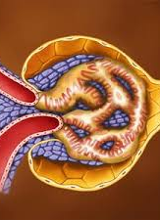
Learning Intentions
Excretory system
The excretory system regulates the chemical composition of body fluids by removing metabolic wastes and regulating water, salts, and nutrients (regulatory processes not required)

Slide 4
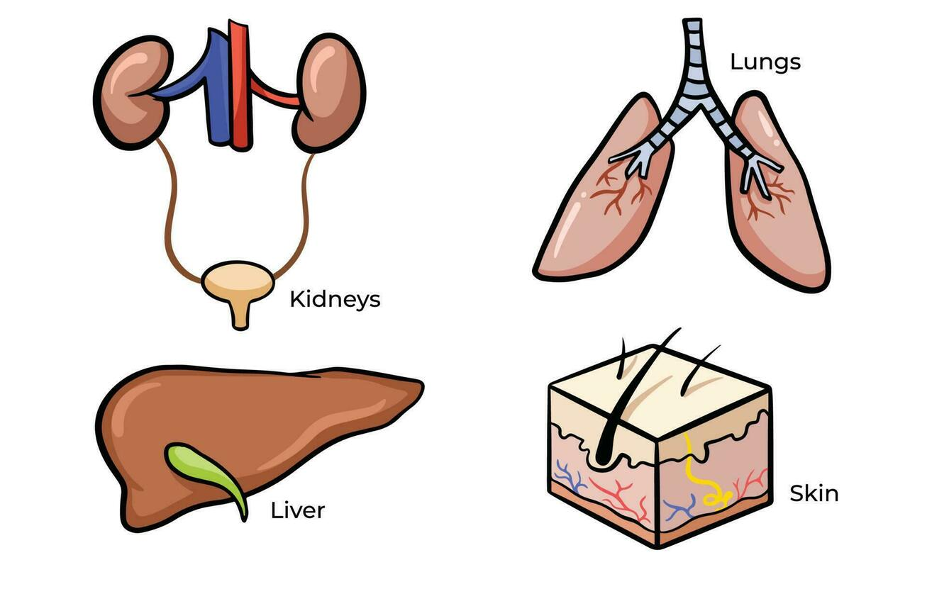
Success Criteria
List organs that process and remove wastes.
Describe deamination.
Label a kidney and a nephron
Describe the three stages of urine formation.

Slide 5
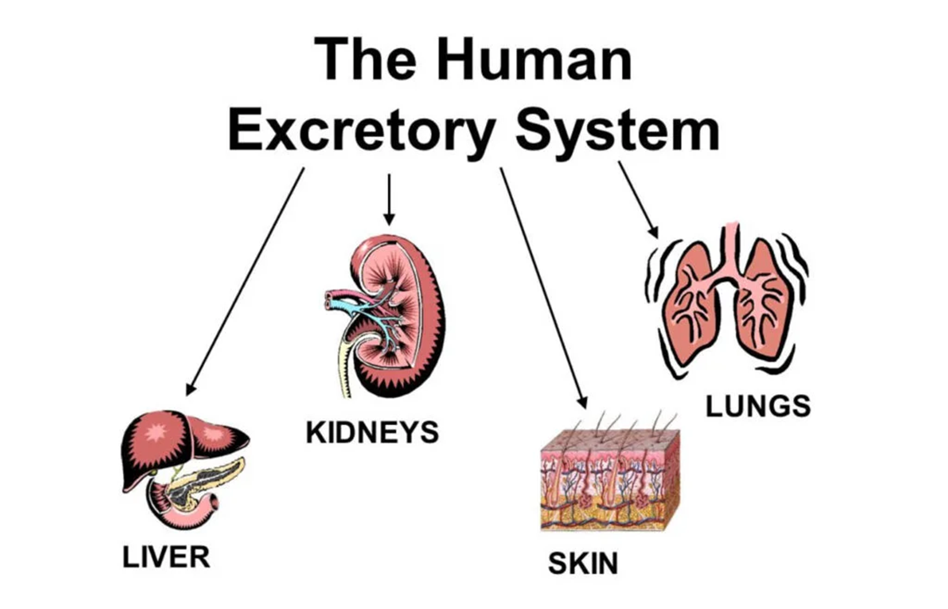
Excretory Organs
Lungs remove carbon dioxide (produced during cellular respiration).
Sweat glands secrete metabolic by-products, eg salts, urea, lactic acid and water.
Liver processes many substances for excretion. Gastrointestinal tract passes out bile salts (by-product of breakdown of haemoglobin).
Kidneys maintain fluid concentrations and remove nitrogeneous wastes, uric acid and creatinine (by-products of protein metabolism).

Slide 6
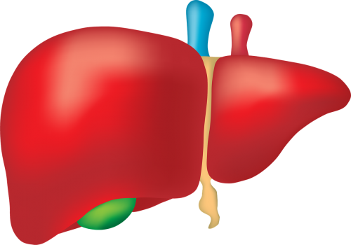
The liver
Proteins are usually recycled by breaking into amino acids for making new proteins, but can also be metabolised as a source of energy.
Deamination of amino acids in the releases amines (-NH2) , which are converted to highly soluble and toxic ammonia (NH3) and then less toxic urea. The urea is excreted from the body in urine and sweat.
The rest of the amino acid becomes carbohydrate.
The liver also metabolises alcohol, medications, hormones and haemoglobin from red blood cells.

Slide 7
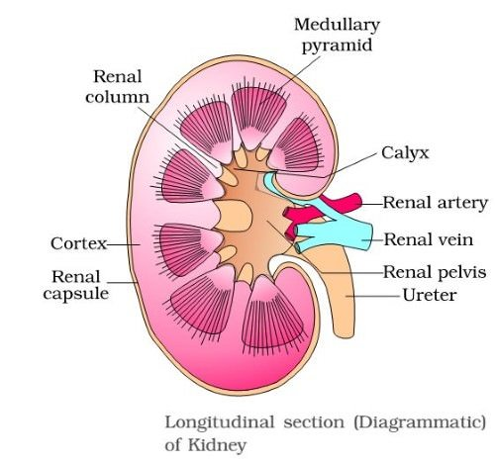
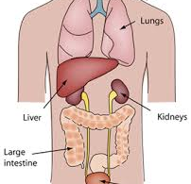
The kidneys
The kidneys remove wastes and regulate blood composition. They are well supplied with blood from the renal arteries, (1/4 of blood from the heart or 1.2 L per minute).
The nephron is the functional unit of the kidney.

Slide 8
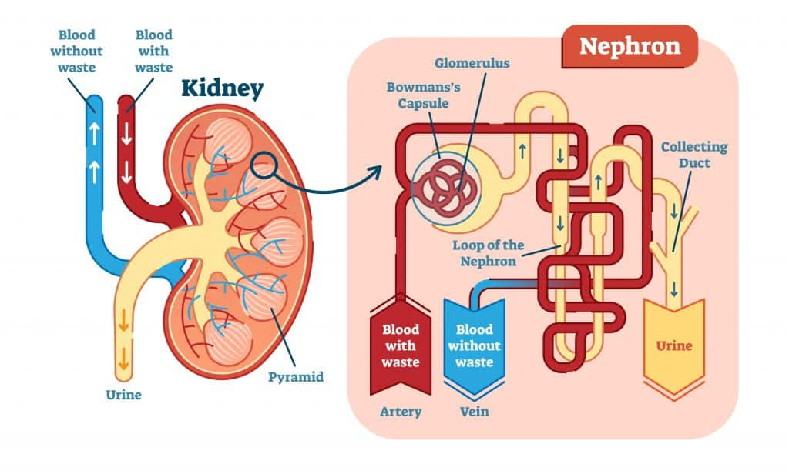

Slide 9
The nephron
Blood is filtered through the glomerular capsule, retaining red and white cells, plasma proteins and about 80% of the plasma. The filtrate, containing water, salts, amino acids, fatty acids, glucose, urea, uric acid, creatinine, hormones, toxins and other ions, is selectively reabsorbed (active) or passes through to become urine.
Tubular secretion (active and passive) selectively adds materials to the filtrate to maintain the pH of the blood and urine.

Slide 10
Success Criteria
List organs that process and remove wastes.
Describe deamination.
Label a kidney and a nephron
Describe the three stages of urine formation.

